Slide 1
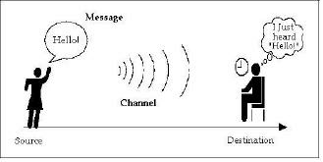
What is communication?
It is just exchange of information between two humans.
Data communication is similarly exchange of information between two computers.
Basic Communication Model
Communication defined more technically can be described as the conveyance of a message from one entity, called the source or transmitter, to another, called the destination or receiver, via a channel of some sort.

Slide 2
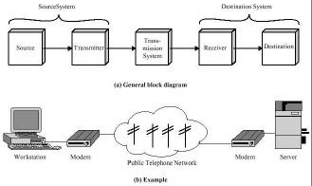
Data Communication
Fig. 1: Simple Data Communication model

Slide 3
Source: Device that generates the data to be passed on to the Destination device. It could be a user computer trying to make a query to a server computer.
Transmitter: If the data generated by the Source device has to be transmitted through Transmission Channel or Transmission System then it has to be presented in a form that is acceptable to the Transmission system. This job is done by the Transmitter.
For example, a modem takes a digital bit stream from the attached computer and transforms that stream of bits into an analog signals which can be handled by the telephone network.
Receiver: This receives the signal from the transmission system and
converts it into a form that is suitable to the destination device.
For example, a modem accepts analog signal from a transmission channel and transforms it into digital bit stream.
Destination: Device to which the source device sends data.
What is the role of the transmission system?
This can be a single transmission line connecting the two systems communicating or a complex network to which numerous communicating systems are connected.

Slide 4
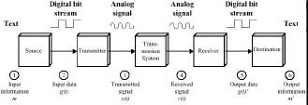
Data Communication Model
Characteristics Essential to a Data Communication System
There are in short three characteristics essential to any data communication system
1. Correct Delivery: When a sender transmits data for an intended recipient, the data must reach only the intended recipient and not another.
2. Accurate delivery: The data sent must be received in the same form as the one in which it was sent. There must not be ant sort of alterations to it in transit.
3. Timely delivery: The data must travel from the sender to the receiver in a finite amount of time.

Slide 5
Signals:
In signal processing, a signal is a function that conveys information about a phenomenon. In electronics and telecommunications, it refers to any time varying voltage, current, or electromagnetic wave that carries information.
In data communication, signal is represented as the electric or electromagnetic encoding of the data.
Encoding is the process of putting a sequence of characters (letters, numbers, punctuation, and certain symbols) into a specialized format for efficient transmission or storage. Decoding is the opposite process -- the conversion of an encoded format back into the original sequence of characters.
At the core of data communications is the concept of signal propagation. Any signal can be classified into one of the two types - analog or digital

Slide 6
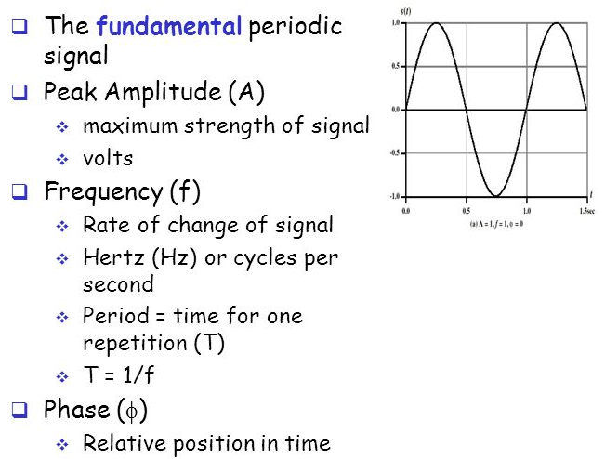
An analog signal is a continuously varying signal, similar to a sinusoidal waveform.
For e.g.: if we measure the room temperature continuously and plot its graph with time on the X axis and temperature on the Y-axis, we would get a continues waveform. This is an example of an analog signal.
Therefore an analog signal is smooth and continuous whereas a digital signal represents a sudden jump from one value to another.

Slide 7
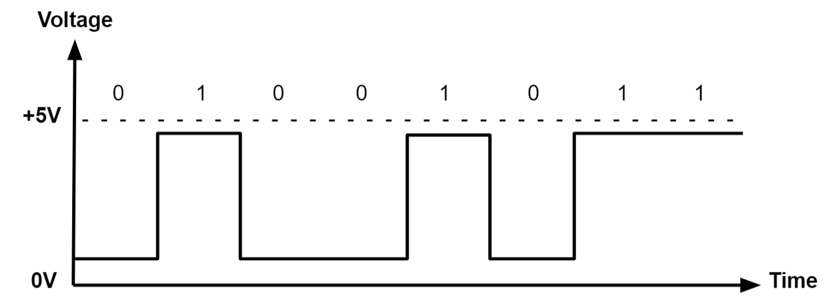
A Digital Signal is one that oscillates between two discrete values over time, never holding an interim value. Typically, a digital signal varies between zero voltage and a positive or negative voltage value
such as pressure and temperature, many instruments provide an output that has one of two states: high or low, open or closed. A pressure might be too high or a temperature too low, triggering closure of a switch.

Slide 8
Why Digital Communication?
There are many advantages of using Digital Communication over Analog Communication. Some of them are listed as below:
The digital communication has mostly common structure of encoding a signal so devices used are mostly similar.
The Digital Communication's main advantage is that it provides us added security to our information signal.
The digital Communication system has more immunity to noise and external interference.
Digital information can be saved and retrieved when necessary while it is not possible in analog.
Digital Communication is cheaper than Analog Communication.
The configuring process of digital communication system is simple as compared to analog communication system. Although, they are complex.
In Digital Communication System, the error correction and detection techniques can be implemented easily.

Slide 9
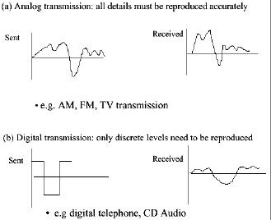
Why Digital Communication?
In analog communication the objective is to transmit a signal waveform, which is a function that varies continuously with time, as shown in Figure 3.3a.
For example, the electrical signal coming out of a microphone corresponds to the variation in air pressure corresponding to sound. This function of time must be reproduced exactly at the receiver output of the analog communication system. In
practice, communications channels do not satisfy this condition, so some degree of distortion is unavoidable.

Slide 10
In digital transmission the objective is to transmit a given symbol that is selected from some finite set of possibilities.
For example, in binary digital transmission the objective is to transmit either a 0 or a 1. This can be done, for instance, by transmitting positive voltage for a certain period of time to convey a 1 or a negative voltage to convey a 0, as shown in Figure 3.3b. The task of the receiver is to determine the input symbol with high probability. The positive or negative pulses that were transmitted for the given symbols can undergo a great degree of distortion.

Slide 11
Line Coding
Line coding is the process of converting digital data a sequence of bits to a digital signal.
Data in the form of text, numbers, graphical images, audio or video are stored in computer memory as sequence of bits.
Line coding converts a sequence of bits to a digital signal. At the sender, digital data are encoded into a digital signal. At the receiver, the digital data are recreated by decoding.

Slide 12
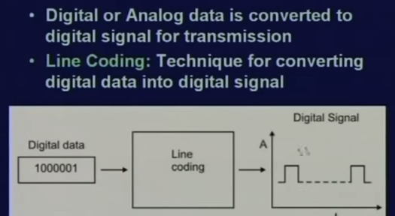

Slide 13
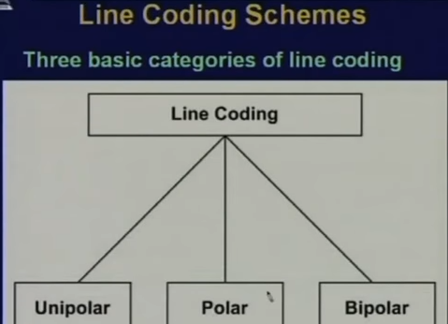

Slide 14
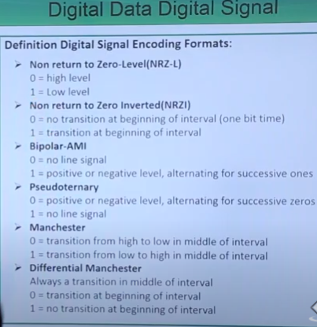

Slide 15
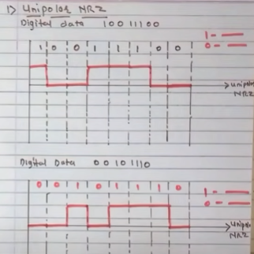

Slide 16
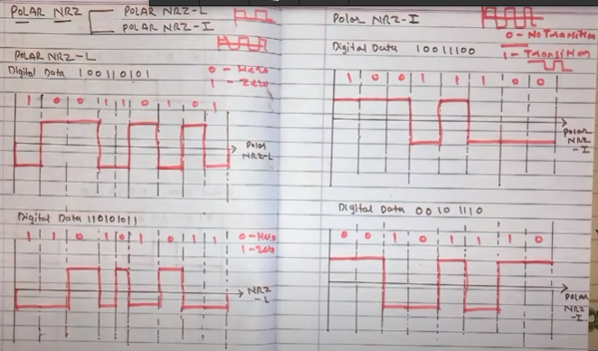

Slide 17
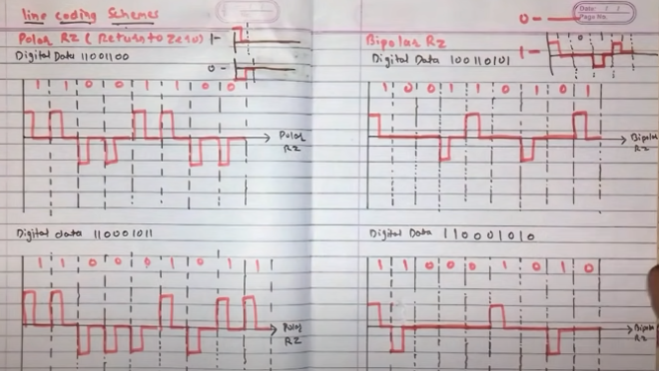

Slide 18
